Slide 1






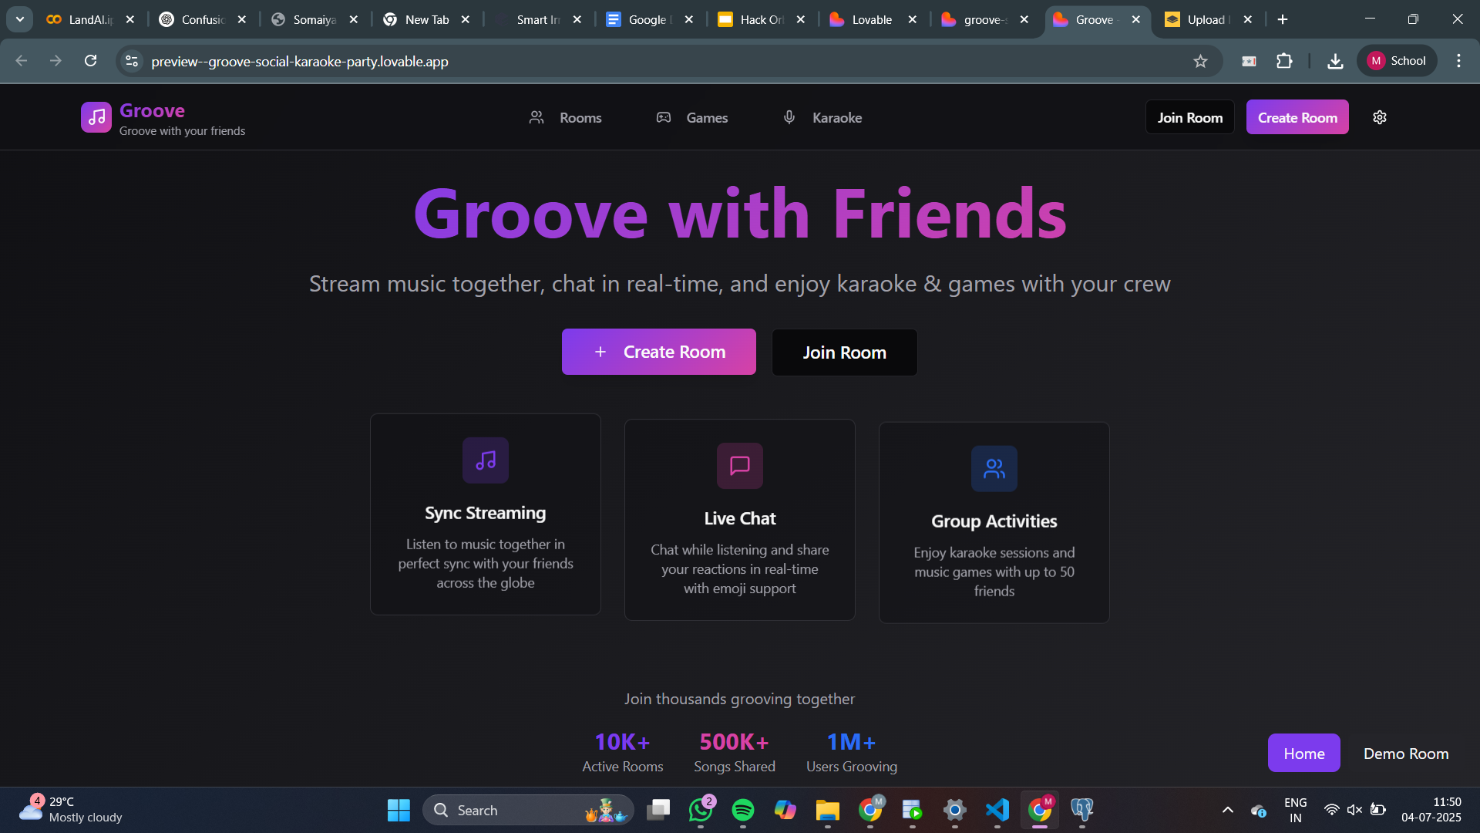
HackOrbit 2025
Team: NoClueCrew

Slide 2

THEME & PROBLEM STATEMENT
It’s Friday night. You and your friends are in different cities, maybe even different countries.
Someone drops a new album, and the group chat is buzzing.
You all want to listen together⭐, react in real time❤️, laugh at the lyrics, and vibe out like you’re in the same room.
But... you’re not.
You try syncing Spotify links, counting “3, 2, 1, play!” over video call. Someone lags. Someone’s audio glitches. And just like that, the moment is gone. What should have been a shared memory turns into a tech mess and individual listening sessions.
We live in a world where everything is connected — from games to movies — so why isn’t music social anymore?

Slide 3

PROPOSED SOLUTION
That’s where Groove steps in.
Imagine this: one link. You and your friends hop into a Groove room. The music starts — in perfect sync — no matter where you are in the world. Everyone hears the same beat, at the same moment. You vibe together, laugh together, maybe even cry together. No lag. No countdowns. Just pure, shared rhythm.
Groove transforms music from a solo experience into a virtual hangout, a digital campfire where you and your crew can connect through sound. Whether you’re chilling with lo-fi on a study night or throwing a virtual party, Groove makes music feel social again — just like it should be.
It’s not just listening. It’s Grooving. Together.

Slide 4
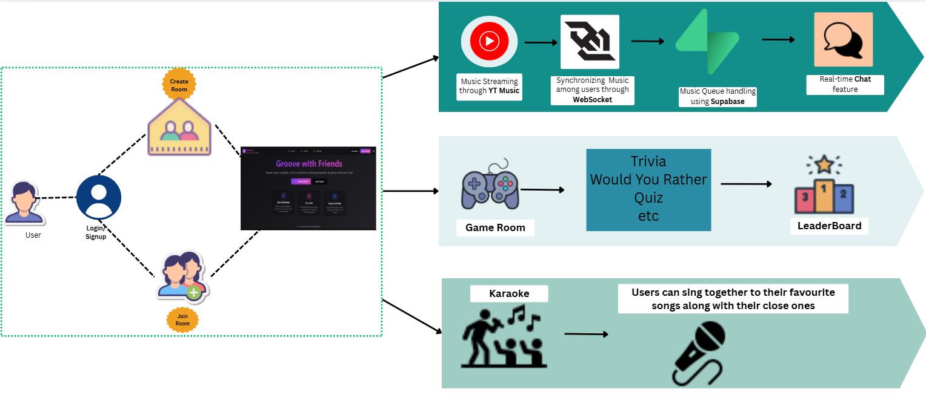






FLOWCHART / DIAGRAM

Slide 5
FLOWCHART / DIAGRAM
Users log in and either create or join a room to enjoy synced music playback with friends. Music is streamed via YouTube Music, synced in real-time using WebSockets, and the music queue is managed with Supabase. A built-in chat feature allows live interaction.
Groove also offers a Game Room with mini-games like trivia and quizzes, with a Leaderboard to keep things fun and competitive.
In Karaoke Mode, users can sing along to their favorite tracks with live lyrics and group participation — making Groove a complete social music experience.
Built with Next.js, Supabase, and Python-based APIs, Groove brings people together through shared music moments, anytime, anywhere.

Slide 6
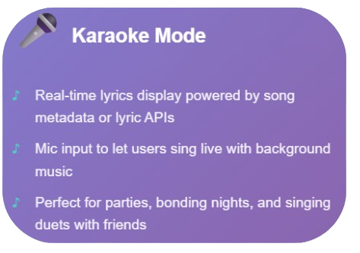
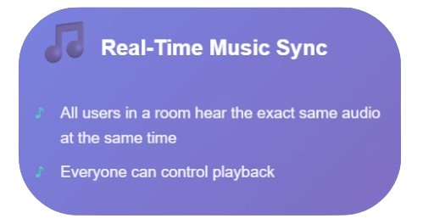
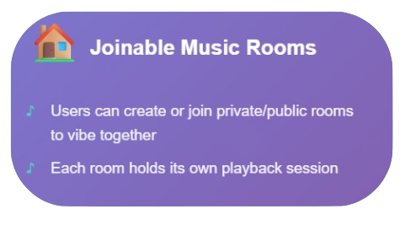
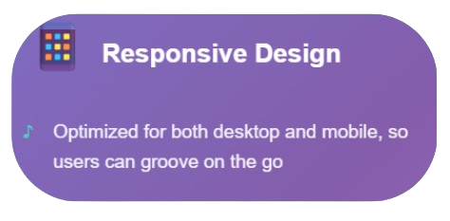
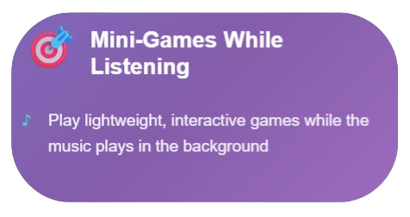
FEATURES AND NOVELTY
Key Features of Groove:

Slide 7
Novelty
What Makes Groove Unique
🎵 Music as a Shared Experience
Unlike Spotify or YouTube where everyone listens solo, Groove brings live, social listening into focus.
🌍 Distance Doesn’t Matter
Groove bridges long-distance friendships, relationships, and communities — all through synced beats
❤️ Real-Time Reactions & Chat
Unlike most music players, Groove lets you interact while listening, making it a truly social music experience.

Slide 8
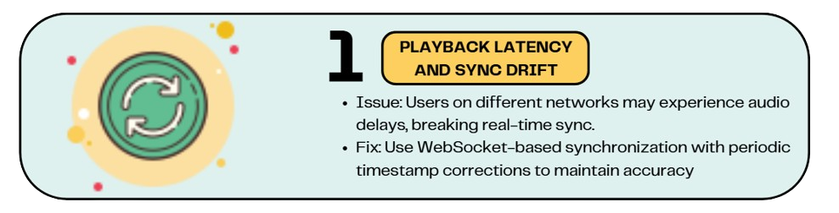
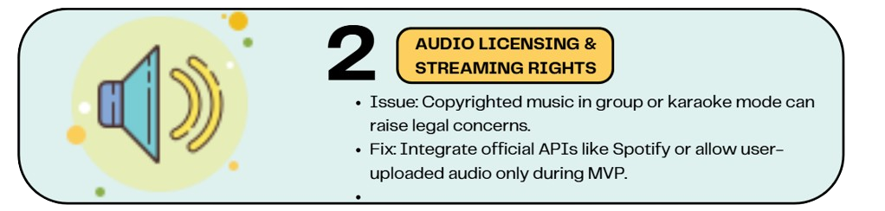
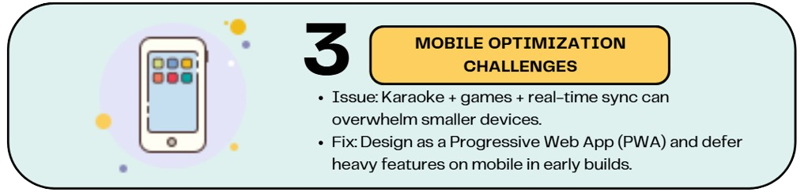
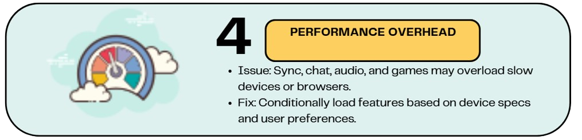
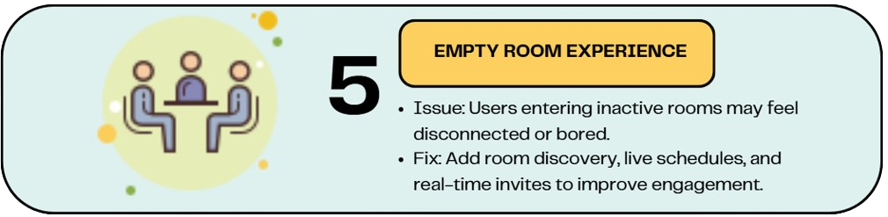
DRAWBACK AND SHOWSTOPPERS

Slide 9
TEAM : NoClueCrew
1)Krisha Pisat-Frontend Dev/Supabase
2)Manasa Lakshmi Ganti-WebSocket/APIs
3)Jash Patel-Supabase Realtime

Slide 10
Thank you

